Slide 1
CSD&A: Data Analysis of SAD IM study with tables and graphs
Consensus
2022.05.24

Slide 2
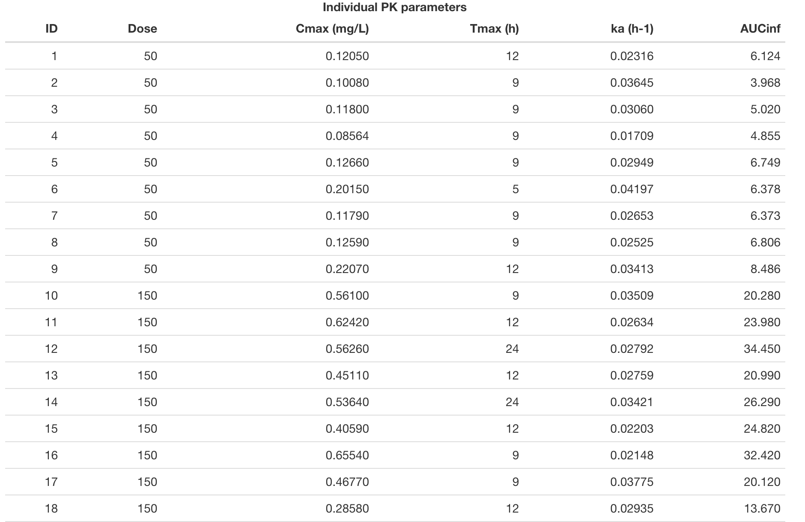
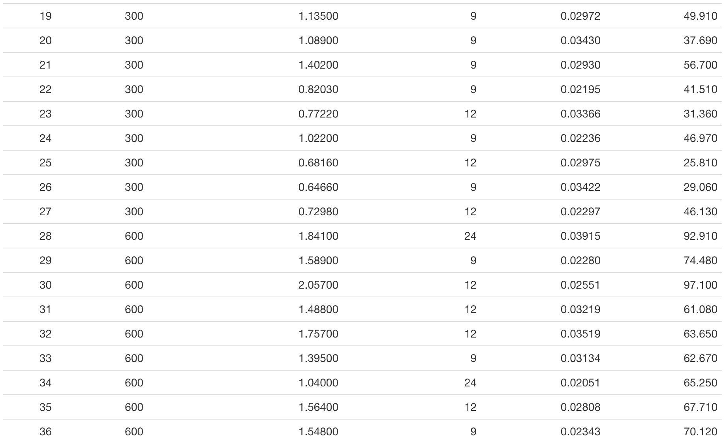
Individual PK parameters

Slide 3
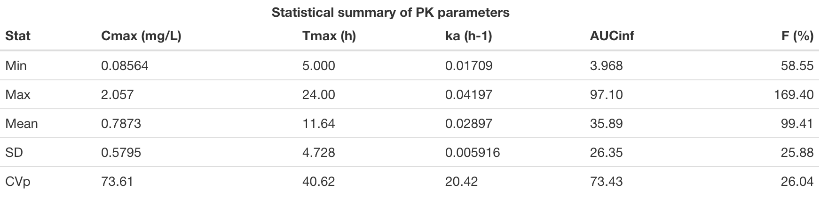

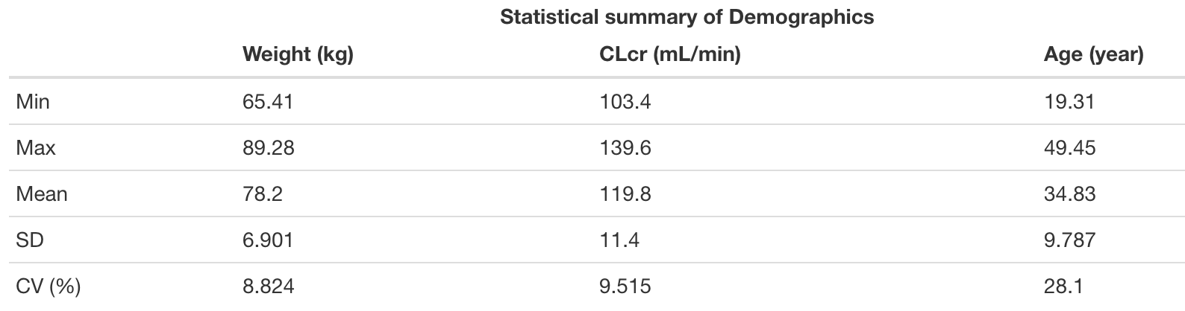
Statistical summary of demographics and PK parameters
From previous phase I IV study: t_{1/2} = ~ 3.15 hours
k_{e} = 0.25 h⁻¹, V = 33 L, CL = 8.25 L/h

Slide 4
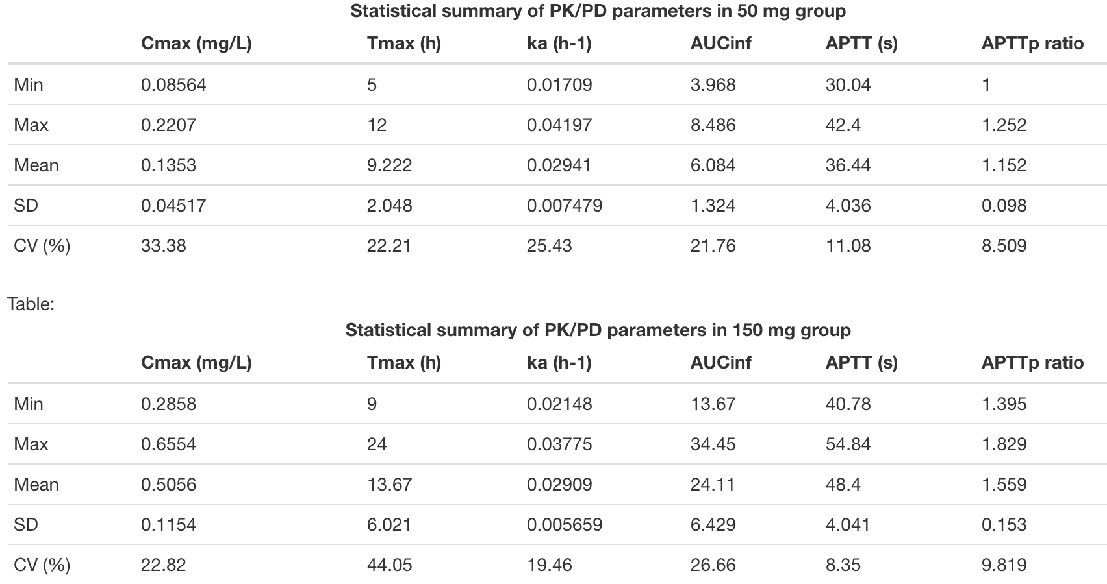
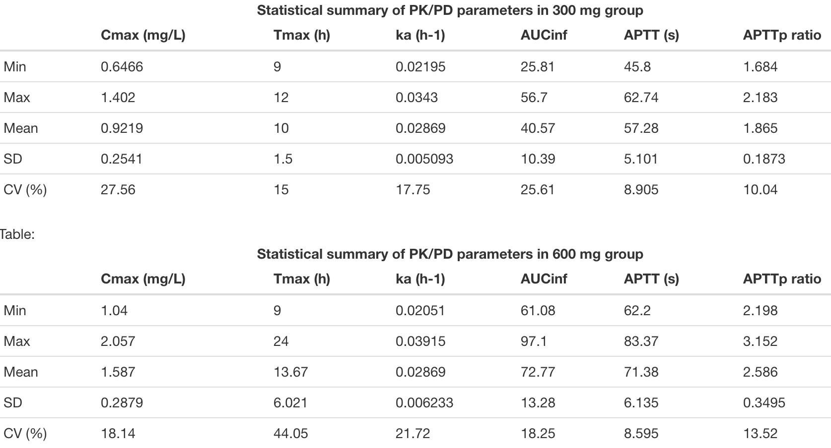
Statistical summary of PK/PD parameters in groups

Slide 5
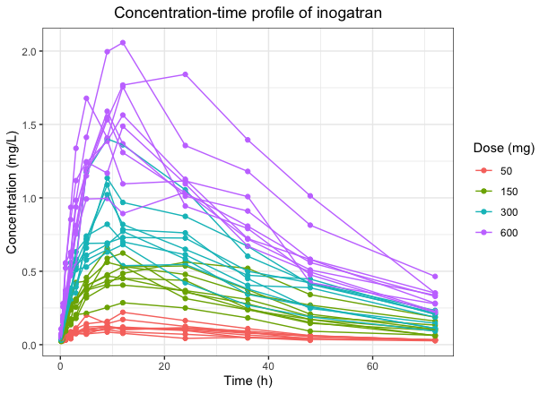
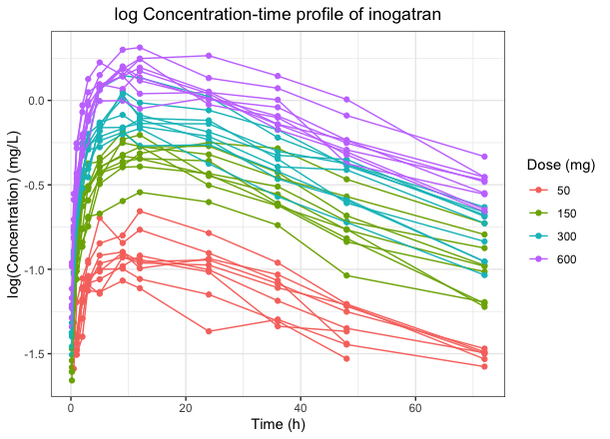
Concentration-time profile of inogatran
T_{max}

Slide 6
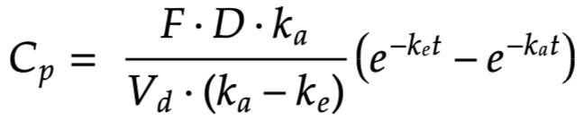
PK model
First-order absorption and first-order elimination
Age, Weight on k_{a}
CrCL on k_{e} (CL is better when evaluating covariates effect in PK model)
Weight on V
PK model with covariates

Slide 7
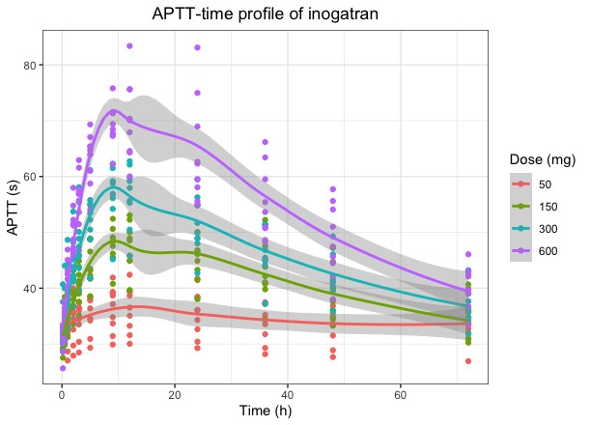
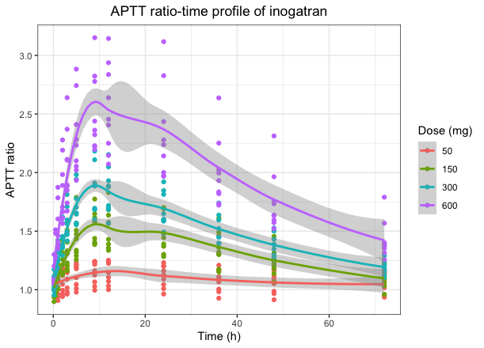
APTT(ratio)-time profile of inogatran

Slide 8
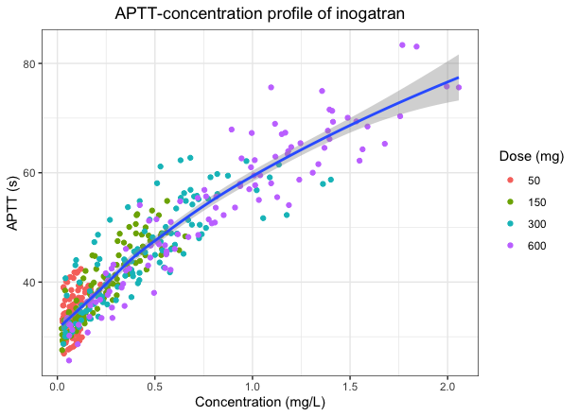
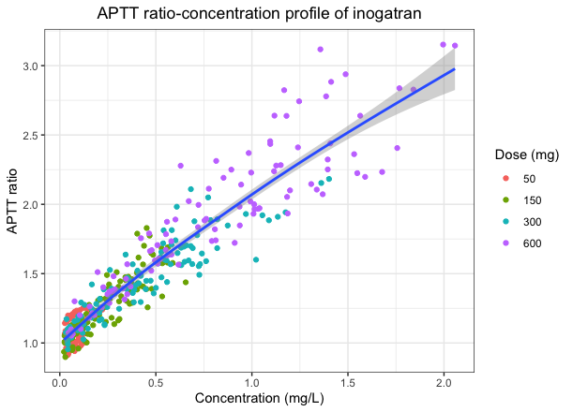
APTT(ratio)-conc profile of inogatran

Slide 9
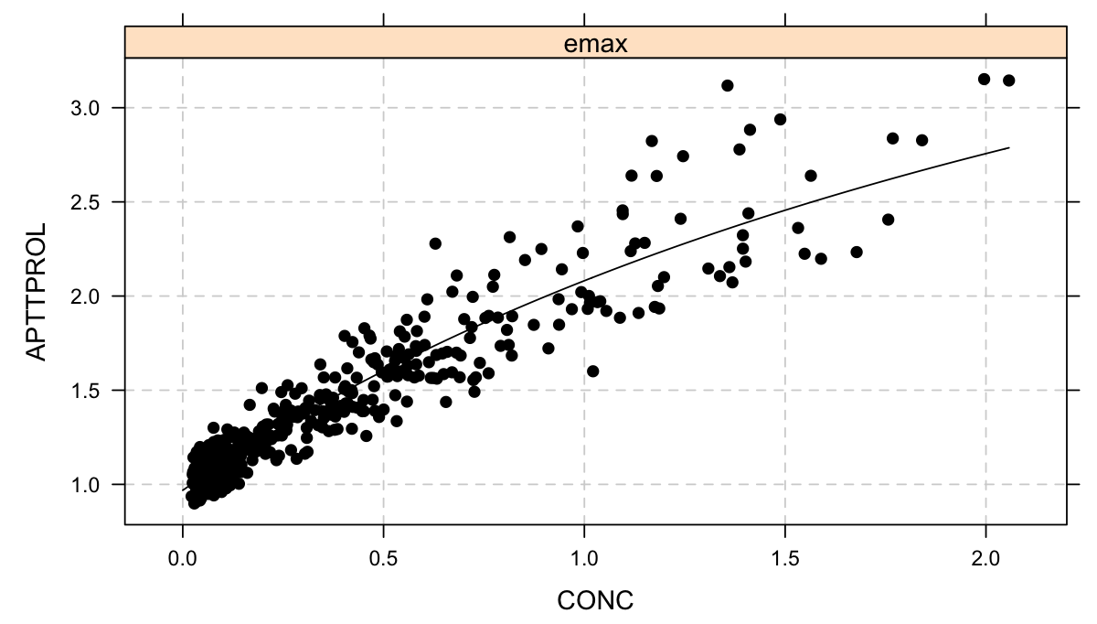
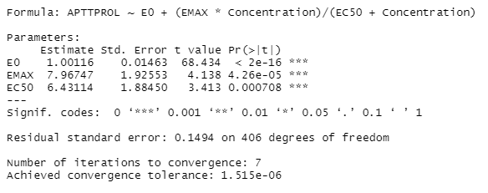
PD model of inogatran
E_{max} model

